Slide 1

ENGR-E 506
INTRO TO NEURO ENGINEERING

Slide 2
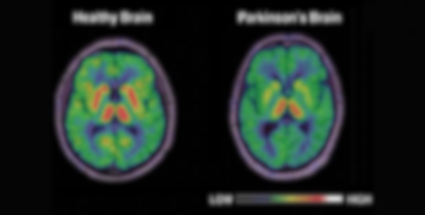
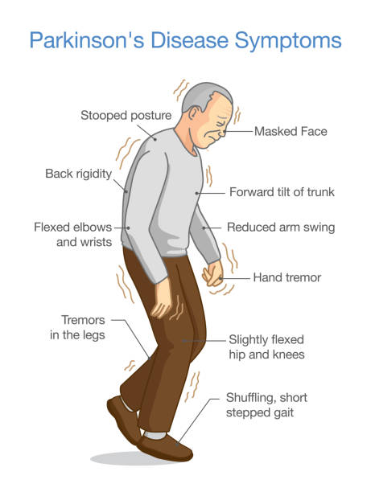
PREDETICTION
FOR
PARKINSON’S DISEASE
Presented by Ruth Balaji

Slide 3

INTRODUCTION
PROBLEM STATEMENT
BLOCK DIAGRAM
MODELS
WORKING
OUTPUT
CONCLUSION
REFERENCE
CONTENT

Slide 4
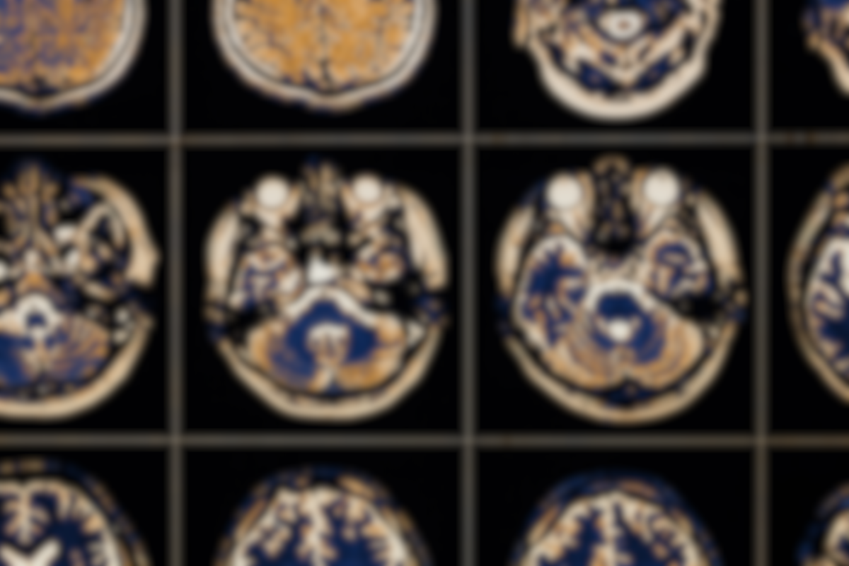
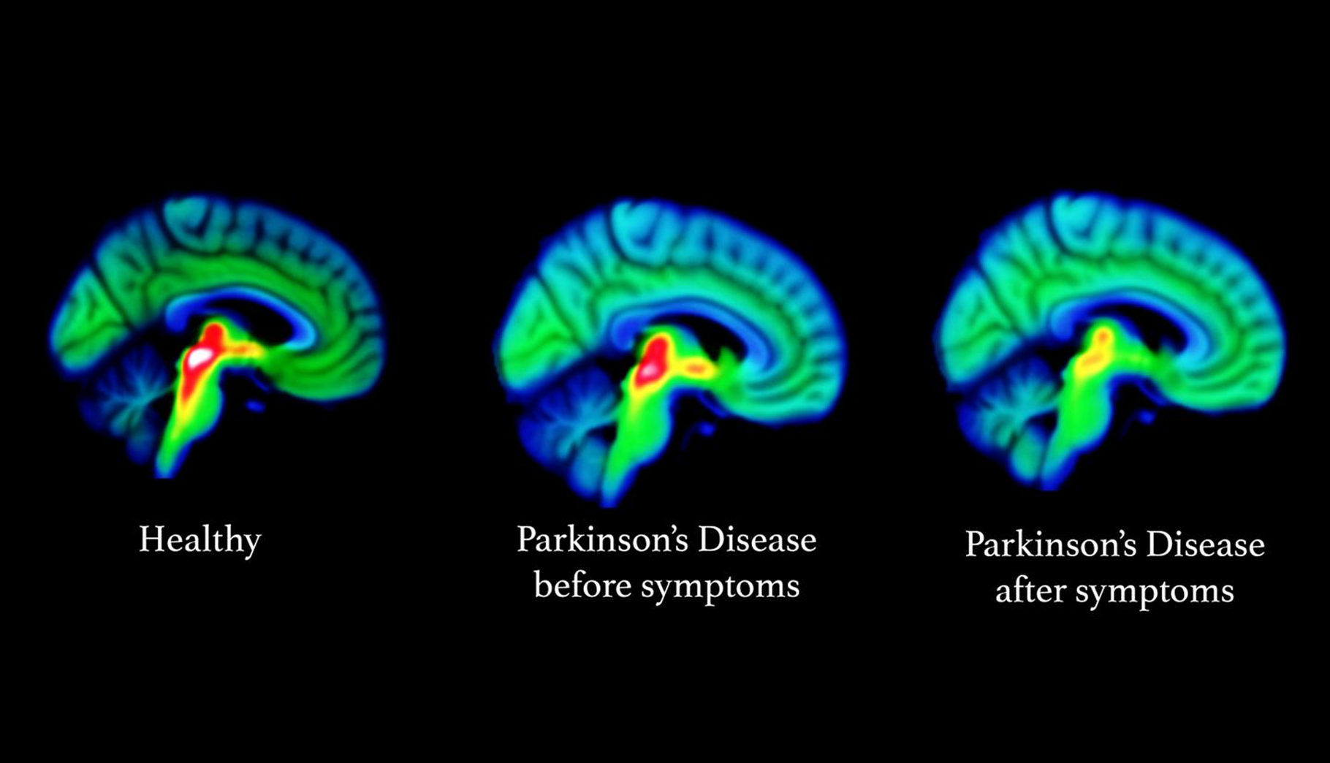
INTRODUCTION
With more than 130,000 cases in the UK and more than 10 million cases globally, Parkinson's disease (PD) is the second most prevalent neurodegenerative ailment. The principal cause of Parkinson's disease (PD) is dopaminergic neuronal loss in the substantia nigra. Tremor, bradykinesia, and stiffness are the three cardinal symptoms of the disease, along with various other patient effects (dementia, poor posture, speech impairment, etc.). Early in the course of the disease, dopamine replacement medication is effective in treating cardinal symptoms.

Slide 5
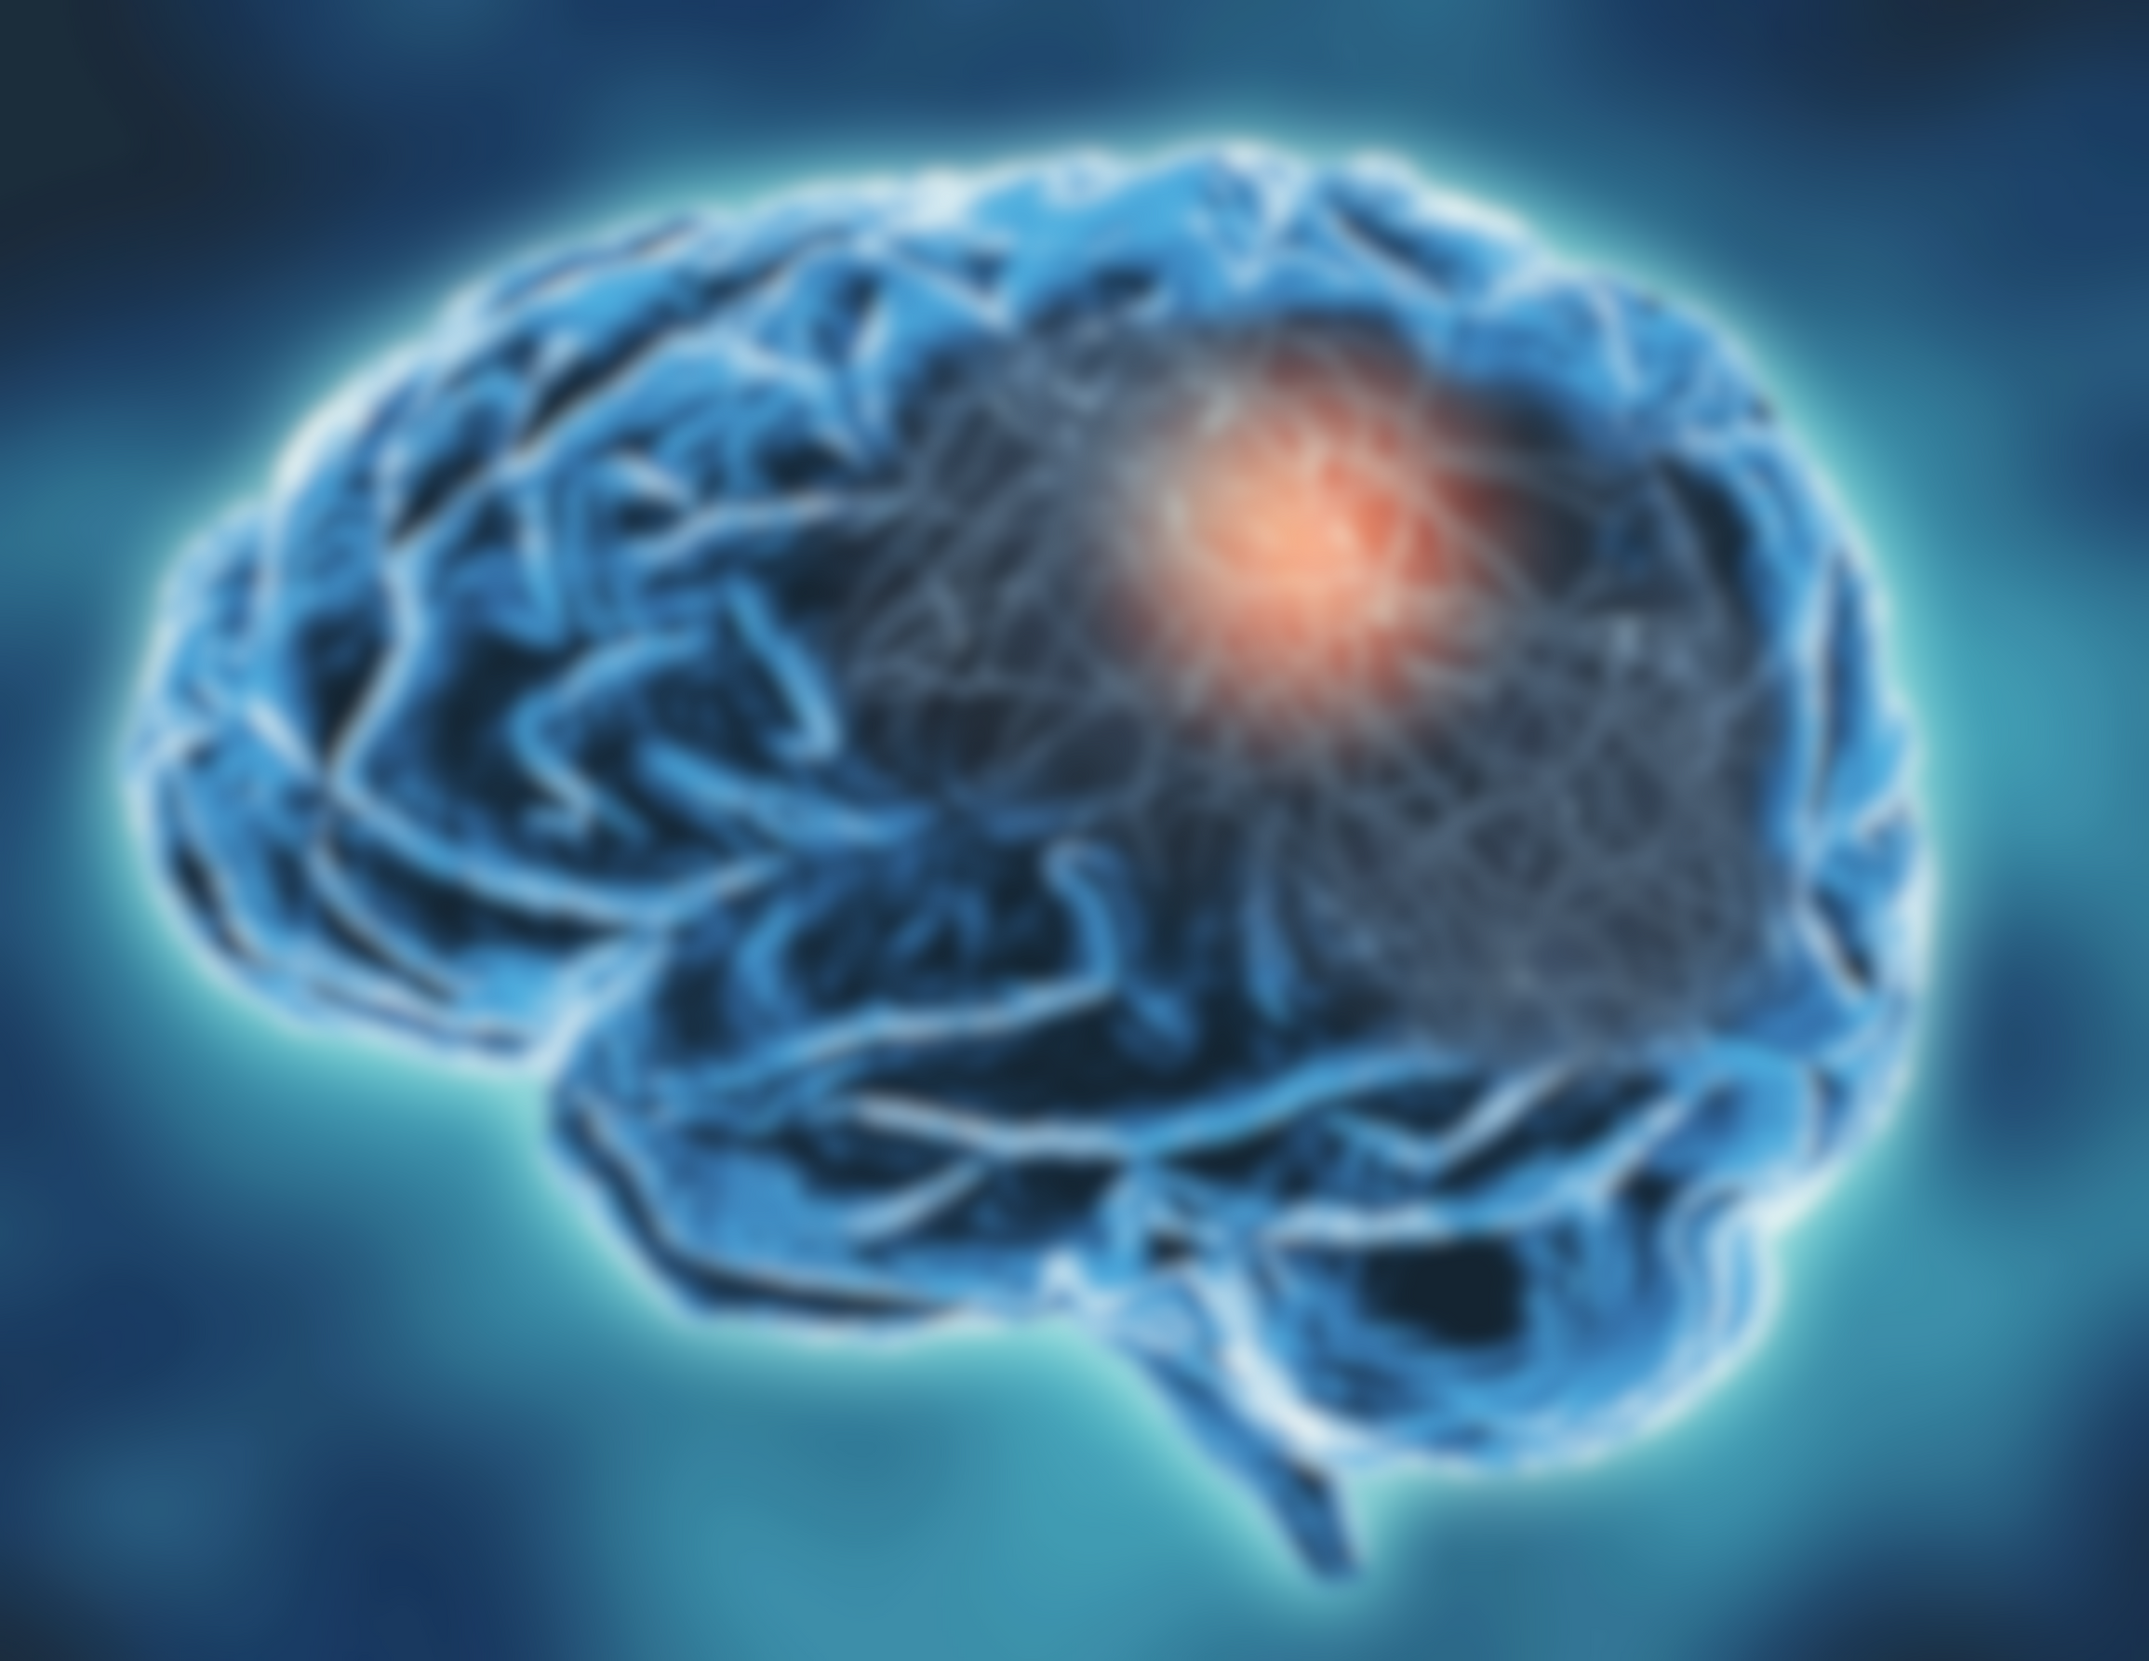
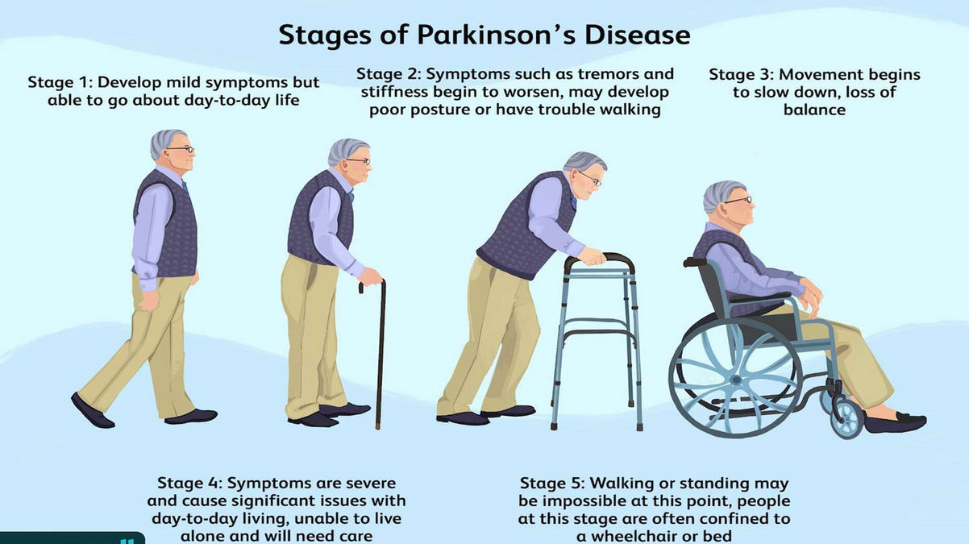
PROBLEM STATMENT
Parkinson's disease (PD) is a progressive neurological illness that has a major negative influence on a person's quality of life. A timely and precise diagnosis is essential to the successful treatment of Parkinson's disease (PD). Here, we provide a machine learning-based method for Parkinson's disease prediction that makes use of a broad dataset that includes clinical history, demographic data, and a variety of motor and non-motor symptoms. The study starts by gathering and pre-processing a large dataset, taking care of problems like outliers and missing values. The purpose of exploratory data analysis is to learn more about the properties of the dataset. In order to improve the interpretability and performance of the model, feature selection approaches are utilized to determine the most pertinent factors that are contributing to the prediction of Parkinson's disease. Because SVM, Decision Trees, and Random Forest are good machine learning algorithms, they are selected for classification problems. To make training and evaluating the model easier, the dataset is then divided into training and testing sets. The model is put through a rigorous training process, and its predictive power is maximized by hyperparameter tuning. Accuracy is one of the evaluation measures used to evaluate the model's performance on the testing dataset. Using more datasets, the model's generalizability and resilience are further confirmed. The results show that the suggested machine learning model has the potential to be a precise and trustworthy tool for Parkinson's disease prediction.

Slide 6
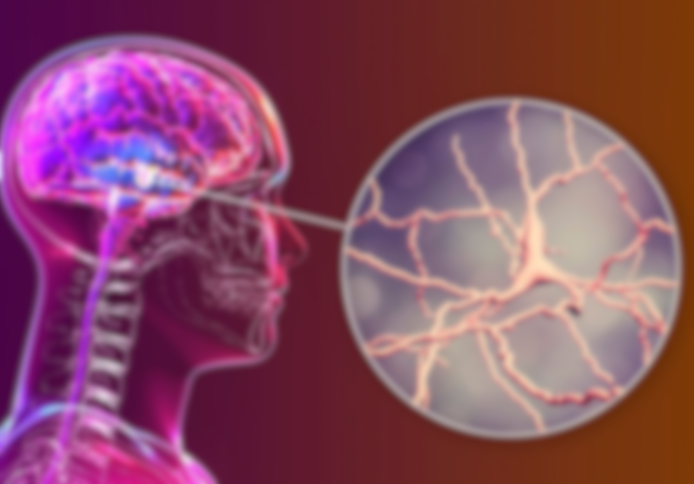
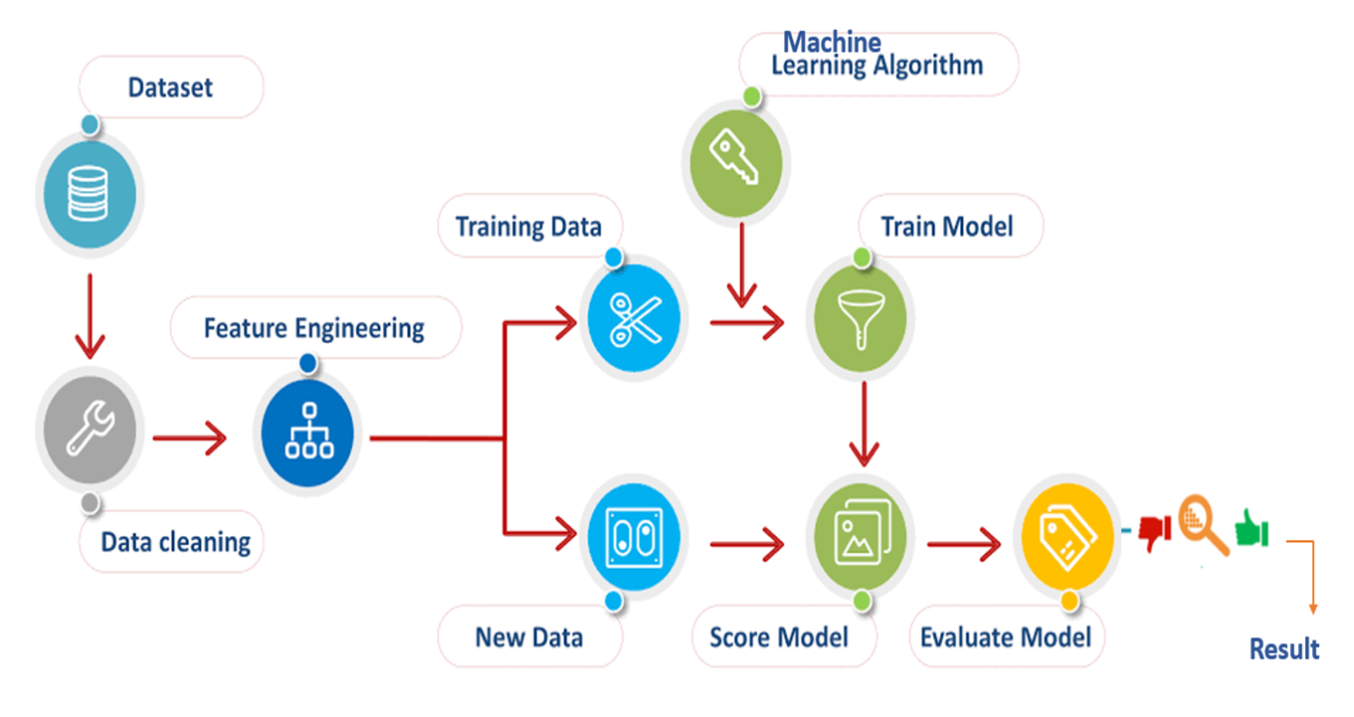
BLOCK DIAGRAM

Slide 7
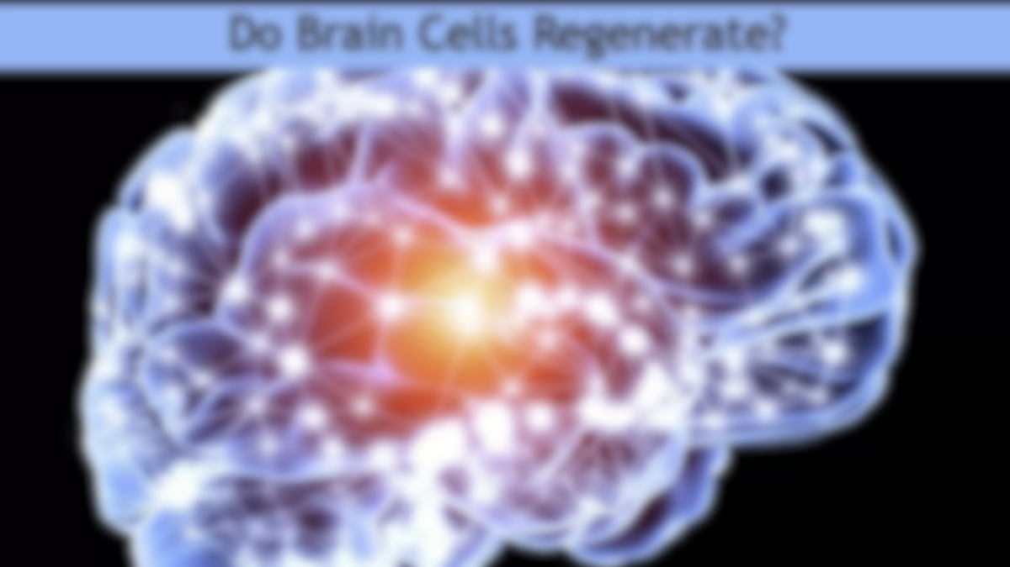
MODELS
SVM
SVM is a supervised machine learning technique that may be applied to regression and classification problems.
It operates by locating the hyperplane in the feature space that best divides various classes.
GAUSSIAN NAIVE BAYES
DECISION TREE
A well-liked classification technique based on the Bayes theorem is called Gaussian Naive Bayes (GNB). Assumptions regarding the data's distribution are made by this probabilistic technique.
A decision tree is a model of decisions and their potential outcomes that resembles a tree.
It divides a dataset into more manageable sections and simultaneously builds a corresponding decision tree separately.
RANDOM FOREST
KNEIGHBOURS
An ensemble learning technique called Random Forest builds a large number of decision trees during training and outputs a class that is the mean prediction (regression) or the mode of the classes (classification) of the individual trees.
To produce a prediction that is more reliable and accurate, it constructs several decision trees and combines them.
KNN is a basic, instance-based learning method that may be applied to regression and classification problems. The way it operates is that it locates the 'k' training examples in the feature space that are nearest to a new input, and then it uses the majority class among those k-nearest neighbors to classify the new input.

Slide 8

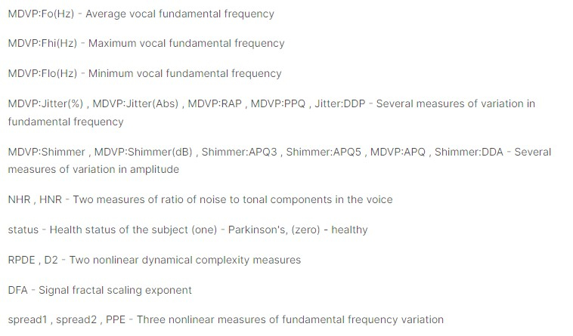
DATASET

Slide 9
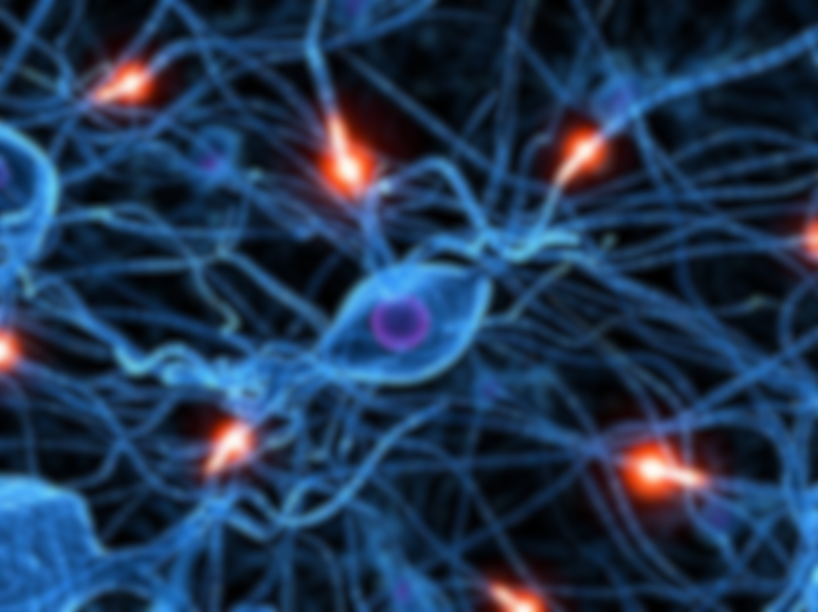
1. Data Loading and Exploration: In this phase, the data was imported, and particular columns were chosen as well as any missing values were checked.
2. Data Visualization: In this phase, the different data's were produced as heatmaps to show the association between the features and histograms were created to show numerical columns.
3. Preprocessing and Splitting of the Data: The data is divided into the target variable (y) and its features (X). The dataset is then divided into testing and training sets.
4. Model Training: Support Vector Machine (SVM), Decision Tree Classifier (DTC), Random Forest Classifier (RFC), K-Nearest Neighbors (KNN), and Gaussian Naive Bayes (gnb) are among the classifiers that are trained. For every model, the accuracy scores on the training data are printed.
5. Prediction: In the end, I used decision tree as it gave me 100% accuracy when training, so I used it to make accurate disease predictions.
WORKING

Slide 10
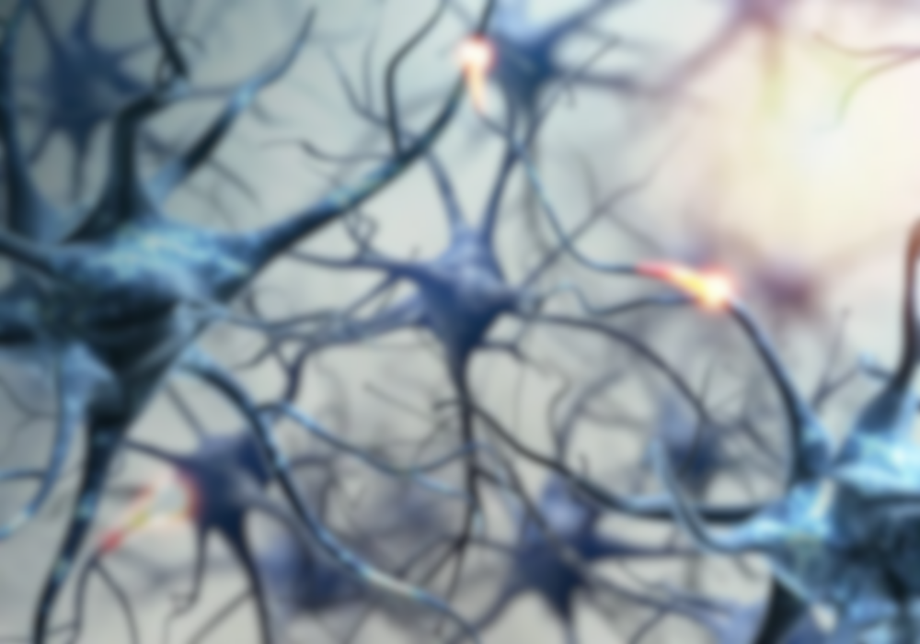
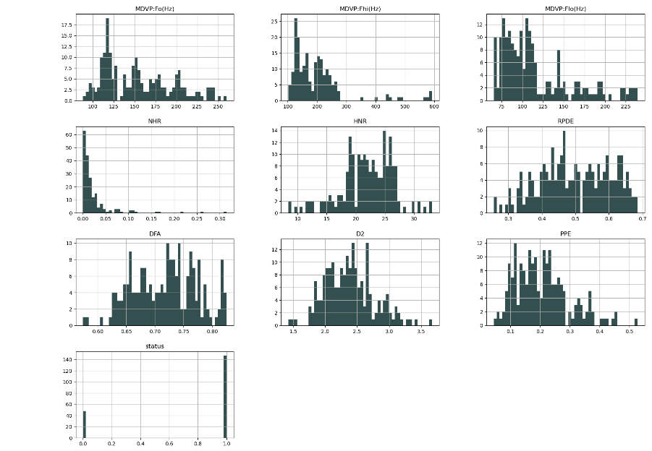
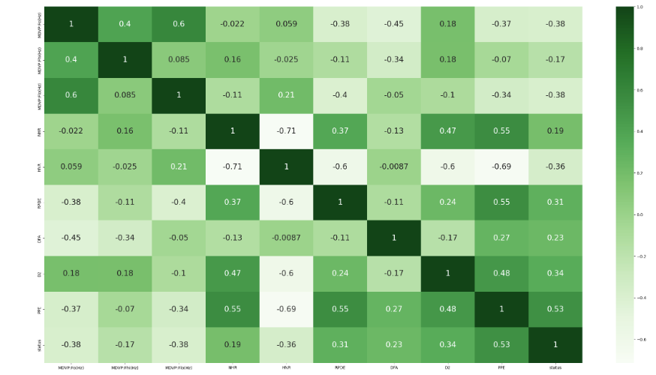
OUTPUTS

Slide 11

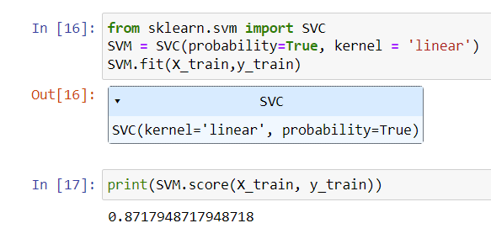
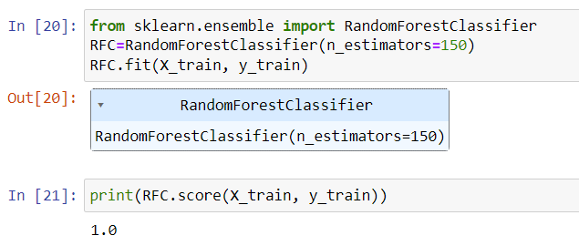
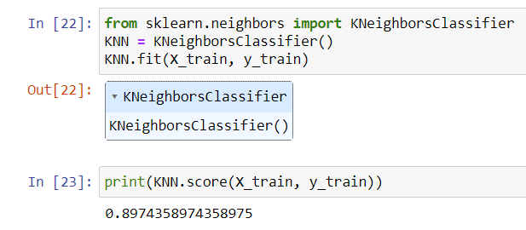
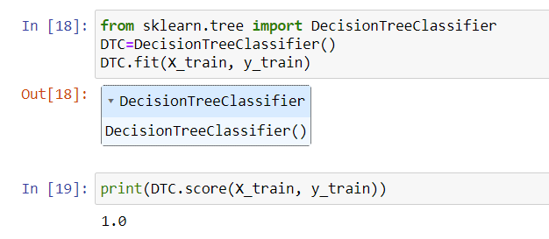
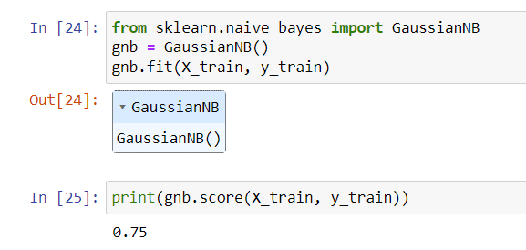

Slide 12

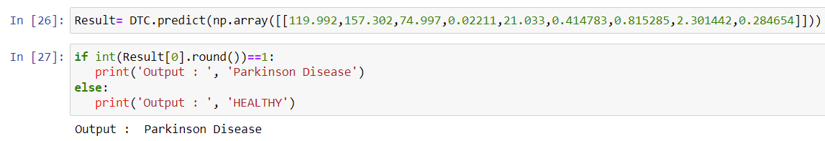
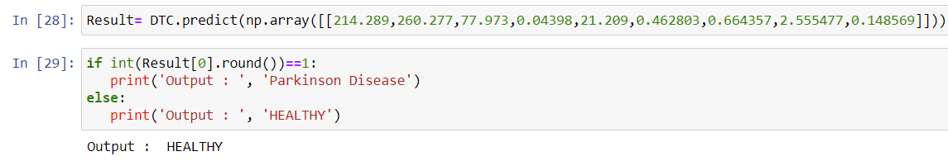

Slide 13
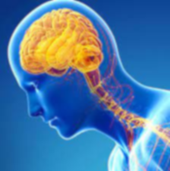
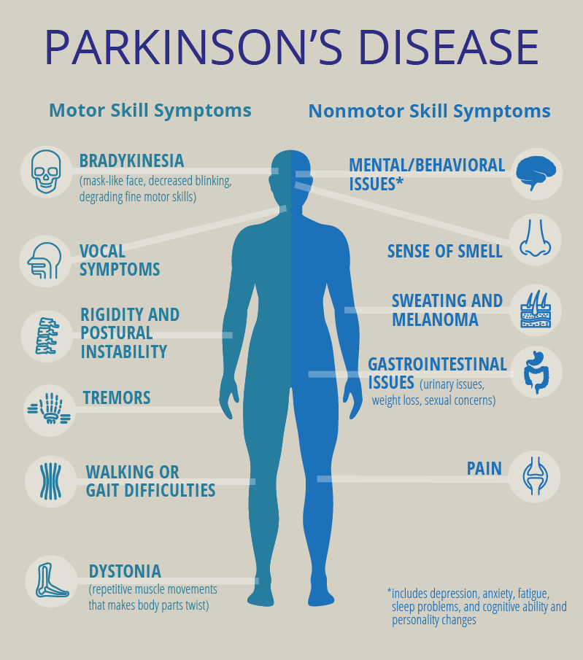
CONCLUSION
I
In conclusion, I was able to successfully predict the diseases and achieve the desired results using the model that provided me with the best accuracy. com

Slide 14
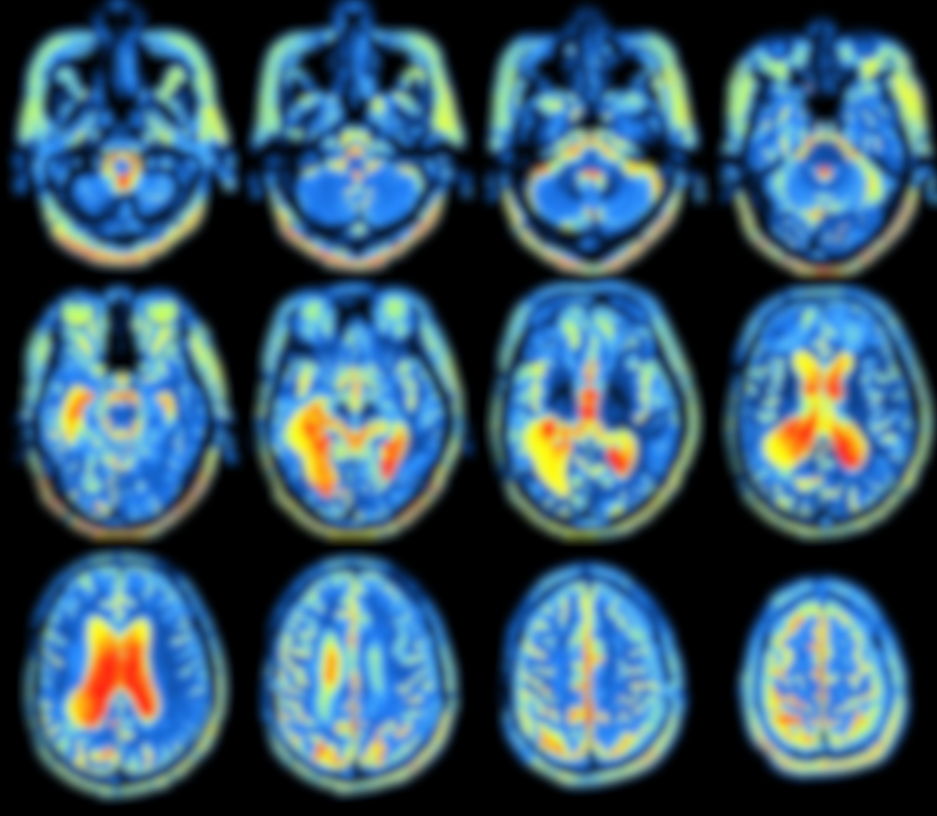
REFERENCE
https://www.kaggle.com/datasets/vikasukani/parkinsons-disease-data-set/code
https://www.kaggle.com/datasets/debasisdotcom/parkinson-disease-detection
https://www.kaggle.com/datasets/dipayanbiswas/parkinsons-disease-speech-signal-features/code
https://www.kaggle.com/datasets/itsmesunil/parkinsons/code

